Slide 1
Create the Product
Chapter Seven

Slide 2
Chapter Objectives
Articulate the value proposition
Explain the layers of a product
Describe how marketers classify products
Understand the importance of services as products
Understand the importance and types of product innovations
Show how firms develop new products
Explain the process of product adoption and the diffusion of innovations
Copyright © 2013 Pearson Canada Inc.
7-<number>
Notes:
p. 222
LECTURE NOTES:
By the end of this chapter, you should be able to:
Articulate the value proposition
Explain the layers of a product
Describe how marketers classify products
Understand the importance of services as products
Understand the importance and types of product innovations
Show how firms develop new products
Explain the process of product adoption and the diffusion of innovations

Slide 3
I. Articulate the value proposition
Copyright © 2013 Pearson Canada Inc.
7-<number>
Notes:
This slide relates to Learning Objective (hereafter LO) #1 of chapter 7.

Slide 4
Build a Better Mousetrap –
And Add Value
Value proposition
    The benefits a consumer will receive when buying the product
Products include tangible goods and intangible products
  Good
    A tangible product, something we can see, touch, smell, hear, taste, or possess
  Intangible products
    Services, ideas, people, places
  Products are viewed as a bundle of attributes
Copyright © 2013 Pearson Canada Inc.
7-<number>
Notes:
This slide relates to LO #1 of chapter 7.
p. 222
LECTURE NOTES:
As we begin our discussion of chapter 7, it’s a good idea to review some of the key concepts introduced in Chapter 1.
Successful products create value for consumers via their value proposition, or more simply put, the benefits that the consumer will receive when buying the product.
Products are tangible goods, or intangible service, or ideas that satisfy the needs of either the ultimate consumer or a business customer by means of the attributes, benefits, functions, or uses that the product offers. Attributes include not only product features, but also aspects of the packaging and the brand name itself.
In creating the value proposition, the marketer must focus on: 1) creating a product or service that provides better value than existing alternatives and 2) crafting marketing communication messages in a manner that convinces customers that the product is better than the competition.

Slide 5
II. Explain the layers of a product
Copyright © 2013 Pearson Canada Inc.
7-<number>
Notes:
This slide relates to LO #2 of chapter 7.

Slide 6
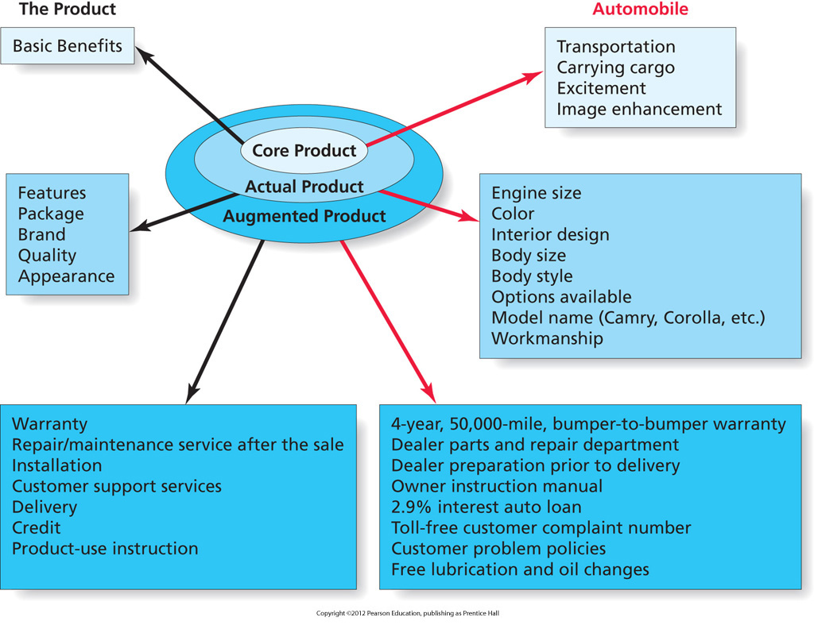
Figure 7.1
Layers of the Product
Copyright © 2013 Pearson Canada Inc.
7-<number>
Notes:
This slide relates to LO #2 of chapter 7.
p. 223
LECTURE NOTES:
A product is everything that a customer receives from a purchase. Figure 8.1 illustrates how a product such an automobile can be broken down into three layers corresponding to the core product, actual product, and augmented product. Marketers need to understand consumers’ needs and wants at EACH level and market their products appropriately. Let’s discuss the three product layers in more detail.
Basic benefits relate to the primary reason why consumers purchase a given product within a product category. Obviously, anyone who purchases a vehicle is looking for transportation – this would be considered a basic benefit. But basic benefits might also be less functional or practical in nature. For example, an individual seeking to enhance their personal status would consider this a basic benefit when purchasing a luxury vehicle. Fun, or driving excitement might also be a primary benefit sought by individuals who purchase sports cars.
The core product is defined as the physical good or delivered service that supplies the desired benefits. Thus the core product includes specific features associated with the physical product, its appearance, the brand, or its package.
The augmented product includes the actual product PLUS other supporting features such as the warranty, service contract, credit and delivery services, installation and training or product use instructions. Many aspects of the augmented product can be adapted or changed much more easily than can the actual product itself. For example, loan rates offered by manufacturer’s fluctuate – low rates may be used to entice consumers to buy at certain times of the year. Similarly, warranties can change, though a change of this nature is more likely to coincide with the start of a new model year.

Slide 7
It’s Debatable
Class Discussion Question
Identify the core, actual and augmented product for either flat screen TVs or your University.
Copyright © 2013 Pearson Canada Inc.
7-<number>
Notes:
This slide relates to LO #2 of chapter 7.
DISCUSSION NOTES:
A good group activity would be to break the class into small groups, and challenge them to identify the different basic benefits of the core product, the attributes of the actual product, and the elements comprising the augmented product in relationship to a product or service that is familiar to them. Some examples include MP3 players, a local well-known restaurant, the University itself, or flat screen TVs.

Slide 8
IN-CLASS ACTIVITY -SERVICE
Identify service industries (such as dentistry, real estate, education, hair saloon,, etc.)
How might these different entities “tangibilize” their product for consumers?

Slide 9
In class Activity 2
Assume that you are employed in the marketing department of the firm that is producing a hybrid automobile.
Develop an outline of how your firm might provide the three product layers in the hybrid car.

Slide 10
III. Describe how marketers classify products
Copyright © 2013 Pearson Canada Inc.
7-<number>
Notes:
This slide relates to LO #3 of chapter 7.

Slide 11
How Long Do Products Last?
Durable goods provide benefits over a period of months, years, decades
    Examples: furniture, appliances, cars
    High-involvement decisions
Nondurable goods are consumed in the short term
    Examples: newspapers, beverages, printer cartridges
    Low-involvement decisions
Copyright © 2013 Pearson Canada Inc.
7-<number>
Notes:
This slide relates to LO #3 of chapter 7.
p. 225
LECTURE NOTES:
Products differ from one another in several ways and it is common for marketers to attempt to classify products in categories, especially when buyers feel differently or behave differently towards products of different categories.
One way that marketers classify products is according to their level of durability, that is, how long they are expected to last.
Nondurable goods are sometimes called consumables, because they are typically depleted or used up in a relatively short amount of time. What are some other examples of nondurable, or consumable items?
Durable goods last much longer and almost always cost more than nondurable goods. Cost and longevity differences are two reasons why durable goods are usually purchased under conditions of high involvement, compared to the low involvement levels which characterize nondurable good purchases.
Marketers must understand how consumer needs for augmented products as well as information differ for durable and nondurable goods. For example, all things being equal, would you expect the warranty to more important for a durable, or nondurable purchase? {Answer: Durable of course}.
Since those who are highly involved in a purchase decision spend more time gathering information and comparing alternatives, marketers can cater to the needs of those looking to purchase a durable good by providing extensive information on the website, via the FAQ section or specific web pages devoted to important actual product features or augmented product aspects.

Slide 12
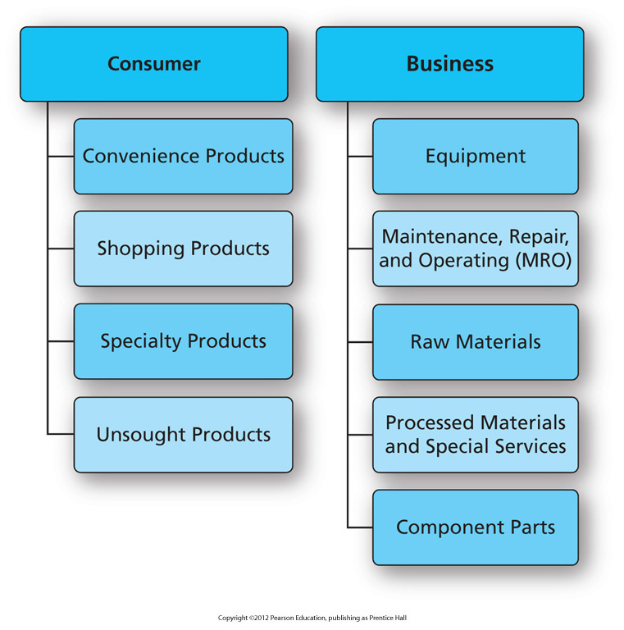
Figure 7.2
Classification of Products
Copyright © 2013 Pearson Canada Inc.
7-<number>
Notes:
This slide relates to LO #3 of chapter 7.
p. 226
LECTURE NOTES:
Marketers also classify products based on their intended usage (by consumers for personal use vs. for business use) and according to either where it is bought (consumer) or the type of item it is (business).
In some cases, the same item (such as a laptop) may be sold to both consumers (as a shopping good) or to a business (as equipment). We’ll discuss the different classifications of consumer and business products in more detail on the following slides.

Slide 13
How Do Consumers Buy Products?
Convenience products
    Are low priced, widely available, and purchased frequently with a minimum of comparison and effort
    Marketers: make the products easily obtainable for consumers
Three types of convenience products
    Staples
    Impulse products
    Emergency products
Copyright © 2013 Pearson Canada Inc.
7-<number>
Notes:
This slide relates to LO #3 of chapter 7.
p. 226 - 227
LECTURE NOTES:
Convenience products are frequently purchased nondurable products that are purchased with a minimum of time and effort. As the name implies, consumers want easy and convenient access to these products, so marketers often try to make them available in as many locations as possible that make sense given the specific type of product in question. Consumers who can’t find their preferred brand will simply purchase a competitive product because they aren’t that invested in the purchase decision.
There are three common subtypes of convenience products:.
Staple products are basic or necessary items that we simply can’t do without. Gasoline and milk are a couple of examples. Can you think of some others?
Impulse products are bought on the spur of the moment. Package designs of items like candy bars need to be bright and colorful so they catch the consumers attention, enhancing the likelihood of an impulse by. In-store placement is also important; many manufacturers of impulse items try to obtain special point-of-purchase displays to make the product standout, or seek to have them stocked near the cash registers where they may be noticed by bored shoppers waiting their turn in line. What’s another example of an impulse item?
Emergency products are items that have to be purchased immediately because of dire need. Because immediate access to the product takes priority, consumers may not consider price or product quality when making their choice. Some examples of emergency products include drain cleaner (when the sink is stopped or overflowing), diapers (when the baby is wet and none are in the house), or an umbrella when you’re outside somewhere and have to stay there, despite the fact that it is raining. Other examples?
WEB VISIT NOTES:
Once you arrive at the CNET website, SEARCH for a particular product class or category, such as voice recorders The search will review results for a number of different brands that fall within a product class or category, along with editor ratings, user ratings, and in some cases, full product reviews. Clicking on the COMPARE box (right hand column) for multiple brands allows the user to compare the different products side-by-side in terms of ratings, features, and price. At the bottom of the comparison, the locations where each brand can be found are shown, along with pricing and in-stock information.
Alternately, if a buyer has selected a particular brand, clicking on the prices shown in the original search results page generated by CNET will bring up a list of vendors who sell the product, their customer rating, and price, inventory, tax, and shipping information.

Slide 14

How Do Consumers Buy Products? (ctn’d)
Shopping products
    Are purchased with considerable time and effort
Specialty products
    Have unique characteristics important to buyers at almost any price
Unsought products
    Are those in which consumers have little interest or awareness until a need arises
CNET.com
Copyright © 2013 Pearson Canada Inc.
7-<number>
Notes:
This slide relates to LO #3 of chapter 7.
p. 227
LECTURE NOTES:
Shopping products are purchased after considerable time and effort is spent gathering information related to prices, stores, different features offered by different manufacturers, and product quality. Since consumers are likely to compare alternatives before making a decision, advertising that facilitates these comparisons can be helpful.
There are a variety of intelligent agents or shopbots that can help both businesses and consumers make comparisons among shopping products. Intelligent agents are computer programs that find sites selling a particular product. For example, CNET.com hosts a shopping bot that finds not only different web sites that sell a particular product, but also different brands within a product category or class. Let’s visit CNET now and see how this works.
Specialty products have unique characteristics important to buyers at almost any price. One example is the Rolex watch. Can you think of another? Consumers are usually pretty knowledgeable about specialty products and tend to be brand loyal. That’s nice, because it means that consumers are willing to go out of their way and travel to purchase their preferred brand.
Specialty products often involve extended problem-solving and consumers may require a lot of time to make their initial decision. Marketers should strive to communicate any type of unique differential (or competitive) advantage offered by their product, if it could be important to the consumer.
Unsought products are those in which consumers have little interest until a need arises. While the same could be said of emergency products, a type of convenience good , unsought products tend to be higher priced, and are often are much more important in the long-term. The challenge then to the marketer is to convince consumers that not only should they be interested in the product, but that they need to buy it now. For this reason, personal selling is often the key to selling many types of unsought products.
Burial plots, and insurance are two examples of unsought products.

Slide 15
Business-to-Business Products
Equipment
    Products used by organizations in daily operations
Maintenance, repair, and operating (MRO) products
    Goods that business customers consume in a relatively short time
Raw materials
    Products of the fishing, lumber, agricultural, and mining industries that organizational customers purchase to use in their finished products
Copyright © 2013 Pearson Canada Inc.
7-<number>
Notes:
This slide relates to LO #3 of chapter 7.
p. 228
LECTURE NOTES:
B2B products are classified by how organizational customers use them.
Equipment is used in daily operations.
One form is heavy equipment, which is sometimes called capital equipment or installations. Examples might include a conveyor system used in a warehouse or as part of a production line, or the robotics used by Ford in the manufacturing of their vehicles.
Computers, copy machines, and water fountains are examples of light or accessory equipment. Normally these types of items are more portable, cost less, and do not last as long as heavy equipment.
Regardless of the type of equipment, marketers commonly rely heavily upon personal selling of equipment in B2B situations.
Maintenance, repair, and operating (MRO) goods are consumed relatively quickly.
Maintenance items include light bulbs, mops, etc., in comparison to repair products, which include small tools, nuts, bolts, and the like. Operating supplies include paper, toner, and the oil that keeps machines running smoothly.
The low cost and straightforward, non-technical nature of these items means most marketers use e-commerce or catalog marketing as the primary method of selling these items, as opposed to personal selling. However, sometimes inside sales representatives will be used to telephone business buyers for supply orders.
Raw materials are products of fishing, lumber, agricultural, and mining industries that are used in the manufacture of finished goods. Milk, soybeans, trees, and ore would be considered examples of raw materials.

Slide 16
Business-to-Business Products (ctn’d)
Processed materials
    Products created when firms transform raw materials from their original state
Component parts
    Manufactured goods or subassemblies of finished items that organizations need to complete their own goods
Copyright © 2013 Pearson Canada Inc.
7-<number>
Notes:
This slide relates to LO #3 of chapter 7.
p. 228
LECTURE NOTES:
B2B products are classified by how organizational customers use them.
Processed materials are produced by firms when they transform raw materials from their original state. So trees are trimmed, cut into boards, and treated. This treated lumber is then purchased by contractors for use in building homes or decks. Specialized services are also purchased by business buyers. For example, a company that manufactures steel panels for use in metal buildings or roofing may purchase painting services from an outside supplier. Alternately, a firm may buy market research or legal services.
Finally, component parts are manufactured goods or subassemblies of finished items that organizations buy to incorporate into a larger product that are building. Ford buys tires – a finished item – and puts those tires on the vehicles they manufacture.
Marketing strategies for both component parts and processed materials involve creating and maintaining relationships with customers, a strength of personal selling.

Slide 17
IV. Understand the importance of services as products
Copyright © 2013 Pearson Canada Inc.
7-<number>
Notes:
This slide relates to LO #4 of chapter 7.

Slide 18
What is a Service?
Services
    Acts, efforts, or performances exchanged from producer to user without ownership rights
Service industry jobs accounted for 75% of Canadian employment and over 2/3 of GDP in 2009
Consumer-oriented services and business services
Copyright © 2013 Pearson Canada Inc.
7-<number>
Notes:
This slide relates to LO #4 of chapter 7.
p. 229
LECTURE NOTES:
Services satisfy needs when they provide pleasure (e.g., movie theatre showings), information (e.g., advertising), or convenience (e.g., online banking).
Services in Canada account for over 2/3 of the GDP. Many forms of marketing careers fall within the service industry (advertising, research, sales, retail, etc.)
Consumer services are easy to identify. Many of these same services (lawn care, insurance, security for example), are also targeted towards businesses, though the scope of services provided to consumers vs. businesses may differ substantially. However, there are also some services and service providers who specifically target businesses exclusively.
DISCUSSION NOTE:
Ask students if they can come up with some examples.
POTENTIAL ANSWERS: Consulting, food services

Slide 19
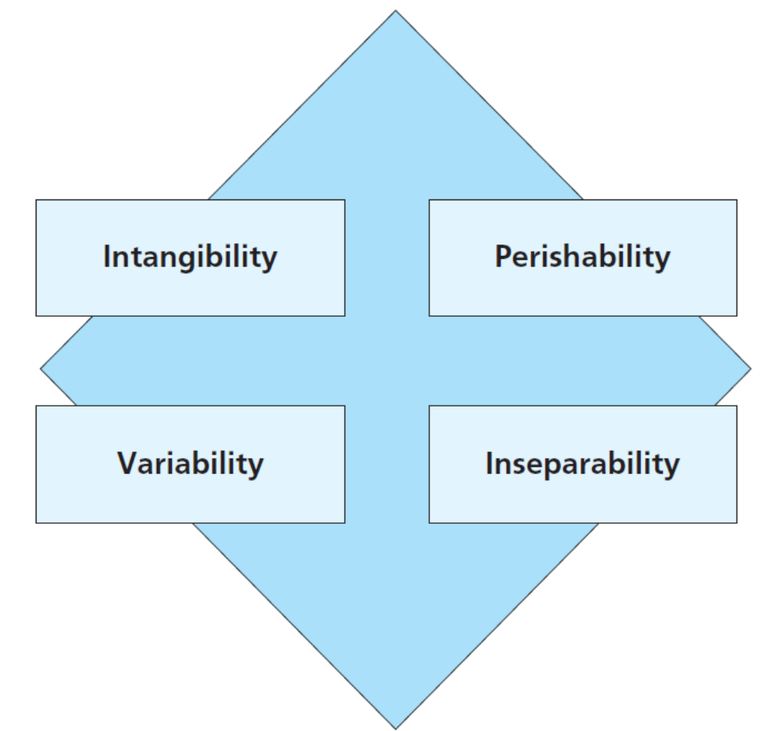
Figure 7.3
Characteristics of Services
Services have four unique characteristics versus products
Copyright © 2013 Pearson Canada Inc.
7-<number>
Notes:
This slide relates to LO #4 of chapter 7.
p. 230
LECTURE NOTES:
All services share four key characteristics.
Intangibility: Can’t see, touch, or smell a service. This means services can’t be inspected or tried prior to purchase, which makes it much more difficult to evaluate services offered by different providers. Thus marketers rely on physical cues to reassure the buyer that they are buying a good service. Cues might include the “look” of the facility, its furnishings, lighting, cleanliness, employee appearance, web site or advertising.
Perishability: Services can’t be stored for later sale or consumption and instead MUST be used at the time they are available. There are so many appointment periods in a doctor’s day . . . An empty slot at 8 am cannot be saved and used later. Capacity management allows firms to adjust their services to match supply with demand. We’ll discuss capacity management in more detail soon.
Variability: Even the same service performed by the same person will vary when delivered on different days or at different times. Lack of standardization is often perceived as a problem. Training can minimize wide variations in service delivery, but it is often difficult to eliminate entirely. Explicit standards and operating procedures may also help to minimize variability, while mystery shoppers and customer feedback can be used to identify cases of poor service quality. However, in many cases, the variability of services actually allows different customers to customize services to their preferences (unique hairstyles).
Inseparability: Because services must be experienced to be used, it is impossible to separate the production of a service from its consumption. Its difficult to detach the expertise, skill, and personality of a provider from the firm’s employees (especially when services are delivered by people).

Slide 20
Characteristics of Services
Intangibility
    Customers can’t see, touch, or smell good service
Perishability
    It is impossible to store for later sale or consumption
    Firms match supply and demand via capacity management
Variability
    Even the same service performed by the same individual for the same customer can vary
Copyright © 2013 Pearson Canada Inc.
7-<number>
Notes:
This slide relates to LO #4 of chapter 7.
p. 230 - 231

Slide 21
Characteristics of Services (ctn’d)
Inseparability
    It is impossible to separate the production of a service from the consumption of that service
Inseparability underscores the importance of service encounter
    Service encounter: the actual interaction between the customer and the service provider
    To avoid bad service encounter, firms turn to disintermediation
    Disintermediation: customers obtain an outcome without the intervention of a human provider
Copyright © 2013 Pearson Canada Inc.
7-<number>
Notes:
This slide relates to LO #4 of chapter 7.
p. 231 - 232

Slide 22
The Service Encounter
The service encounter has several dimensions
Social contact dimension
Physical dimension
Customer also plays a part in the service encounter
The quality of a service is only as good as its worst employees
Copyright © 2013 Pearson Canada Inc.
7-<number>
Notes:
This slide relates to LO #4 of chapter 7.
p. 232

Slide 23
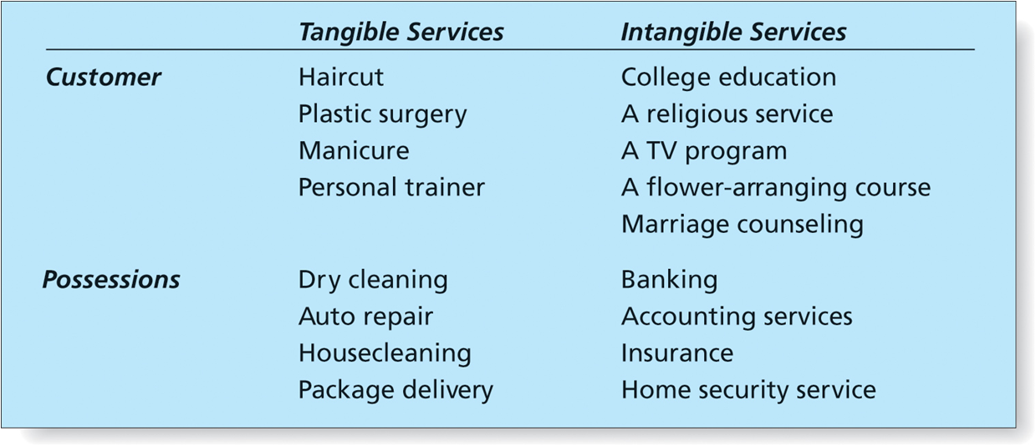
Table 7.1
Classifying Services
Copyright © 2013 Pearson Canada Inc.
7-<number>
Notes:
This slide relates to LO #4 of chapter 7.
p. 233
LECTURE NOTES:
Services can be classified according to whether they are performed directly on the customer (haircut) or on something the customers owns (oil change for car), and whether the service itself consists of tangible (heart transplant results in a new heart) or intangible (knowledge imparted through college courses) actions.
In reality, most products are a combination of goods and services. Even tangible goods such as furniture contain service components, such as “stain-proofing” and furniture delivery and set up. Thus products vary in terms of their level of tangibility and tend to be dominated by either intangible or intangible elements.

Slide 24
How We Classify Services
Goods-dominated products
    Firms that sell tangible products still provide support services
Equipment- or facility-based services
    Operational factors, locational factors, and environmental factors are important
People-based services
    Increasing in importance as people lack the time or expertise to do on their own
Copyright © 2013 Pearson Canada Inc.
7-<number>
Notes:
This slide relates to LO #4 of chapter 7.
p. 232 - 235
LECTURE NOTES:
To better make sense of how services are classified, it may be helpful to think of service offerings as falling into one of three categories.
Goods dominated products will still offer some type of support service, such as warranties, 1-800 phone numbers, or FAQ sections of the brand website. In B2B markets, the service aspect cannot be ignored as most firms would simply refuse to consider a vendor that did not offer expected services (training on how to use a copy machine for example, or online ordering of toner). Brands that offer superior service can realize a competitive advantage (e.g., faster service when fixing a copier).
Equipment- or facility-based services are those that include a mixture of tangible and intangible elements. Airlines, tanning salons, and automatic car washes are a few examples. Operational, locational, environmental factors should be of concern to marketers. Here’s why:
Operational factors: Signs and guidelines help firms minimize wait times. Many hotels have moved to check-out via the in-room TV system to minimize wait time. Warehouse clubs such as Sam’s have roving employees that prescan consumers’ purchases while waiting line.
Locational factors: especially important for frequently used services – goal is to locate service centers where most convenient. Thus there are multiple ATM locations for a particular bank branch, for example. Restaurants locate near major employers or other shopping venues.
Environmental factors: Atmospheric factors such as lighting, design, color, art can create attractive environments for consumers. Strong lighting in the parking lot and key card entry systems that lock outer doors after 10 pm can promote a safe environment for hotel guests.
Lawyers, doctors, personal trainers, entertainers, agents, athletes/professional sports teams, educators—each of these examples falls under the people-based service category.
ASK students to provide examples of equipment or facility based operational factors, locational factors, and environmental factors.
Potential examples

Slide 25
Core and Augmented Services
Core services
    The basic benefits of having a service performed
Augmented services
    Additional services that enhance value
    Augmented services help to differentiate businesses from one another
Copyright © 2013 Pearson Canada Inc.
7-<number>
Notes:
This slide relates to LO #4 of chapter 7.
p. 235
LECTURE NOTES:
While customers generally seek a core service, it’s often the augmented services which provide extra value that differentiate one business from another.
For example, Porters Dry Cleaners is a high-end dry cleaning chain in Northwest Louisiana. They offer augmented services in the form of curbside pick up (employees come out to get dry cleaning) and covered parking to patrons, along with their core fine dry cleaning services and bridal gown preservation. What type of augmented services are offered by hotels? {Answers: restaurant, in-room Internet, business center, concierge assistance}

Slide 26
IN-CLASS ACTIVITY- SERVICE
List and describe the core and augmented services of each of the following:
A personal trainer
An accountant
A drycleaner
A public swimming pool
Your personal banker
How do marketers increase market share with augmented service

Slide 27
How We Provide Quality Service
Quality service ensures that customers are satisfied with what they have paid for
Satisfaction is based on customer expectations
Marketers must identify and exceed customer expectations
In case of service failures, marketers need to offer logical explanations and customer compensations
Copyright © 2013 Pearson Canada Inc.
7-<number>
Notes:
This slide relates to LO #4 of chapter 7.
p. 236

Slide 28
Service Quality Attributes
Search qualities
    Characteristics that the consumer can examine before purchase e.g. room décor or uniform
Experience qualities
    Characteristics that buyers can determine during or after consumption e.g. determining how good a vacation will be
Credence qualities
    Characteristics that are difficult to evaluate even after they have been experienced e.g. knowing if a physician’s diagnosis is correct
Copyright © 2013 Pearson Canada Inc.
7-<number>
Notes:
This slide relates to LO #4 of chapter 7.
p. 237
LECTURE NOTES:
Search qualities: Characteristics that the consumer can examine before purchase, such as color, style, fit, and price. Since many services are intangible, services need to focus on how uniforms, or room décor as proxies for these search qualities.
Experience qualities: Characteristics that buyers can determine during or after consumption. For example, it’s difficult to predict how good of a time one will have on vacation, so marketers use their communications to try and reassure consumers before the fact that they will enjoy their stay, so long as false expectations aren’t set.
Credence qualities: Characteristics that are difficult to evaluate even after they have been experienced. For example, most people don’t have the knowledge or ability to know whether a physician’s diagnosis is correct. It’s only after the surgery has been performed or the medicine has been taken, that consumers will know – based on whether they recover from their illness or not.

Slide 29
It’s Debatable
Class Discussion Question
What are some of the search, experience, and credence qualities associated with higher education?
Copyright © 2013 Pearson Canada Inc.
7-<number>
Notes:
This slide relates to LO #4 of chapter 7.
DISCUSSION NOTES:
Ask students to identify the search, experience, and credence qualities associated with higher education. Some examples:
Search qualities could include the dormitory room, student union, sports arena, computing lab, science laboratories and classrooms, as well as tuition cost, published graduation rate, percentage of faculty holding terminal degrees, etc.
Experience qualities could include the perceived quality of student life, the degree of difficulty associated with completing coursework, parking availability, convenience of attending classes, etc.
The key credence quality pertains to whether or not the student learned what he or she needs to know to enjoy a successful career.

Slide 30
How We Measure Service Quality
SERVQUAL scale measures customer perceptions of five key dimensions
  Tangibles
  Reliability
  Responsiveness
  Assurance
  Empathy
Copyright © 2013 Pearson Canada Inc.
7-<number>
Notes:
This slide relates to LO #4 of chapter 7.
p. 237 – 238
LECTURE NOTES:
The SERVQUAL research has identified five dimensions (or components) of service quality:
Tangibles: the physical facilities and equipment and the professional appearance of the personnel
Reliability: the ability to provide dependably and accurately what was promised
Responsiveness: the willingness to help customer and provide prompt service
Assurance: the knowledge and courtesy of employees and the ability to convey trust and confidence
Empathy: the degree of caring and individual attention customer receive
The SERVQUAL instrument is used by thousands of businesses. It is usually administered in a survey format (paper and pen survey, internet survey, or in much rarer instances, phone survey). Such firms will often track these ratings over time (in what is called a longitudinal study) to document how service quality is improving (hopefully).

Slide 31
Gap Analysis
Gap analysis
    A marketing research method that measures the difference between a customer’s expectation of a service quality and what actually occurred
Five major gaps are identified
Copyright © 2013 Pearson Canada Inc.
7-<number>
Notes:
This slide relates to LO #4 of chapter 7.
p. 238 – 240

Slide 32
Gap Analysis (ctn’d)
Gap between consumers’ expectations and management’s perceptions
Gap between management’s perception and quality standards the firm sets
Gap between established quality standards and service delivery
Gap between service quality standards and consumers’ expectations
Gap between expected service and actual service
Copyright © 2013 Pearson Canada Inc.
7-<number>
Notes:
This slide relates to LO #4 of chapter 7.
p. 238 – 240

Slide 33
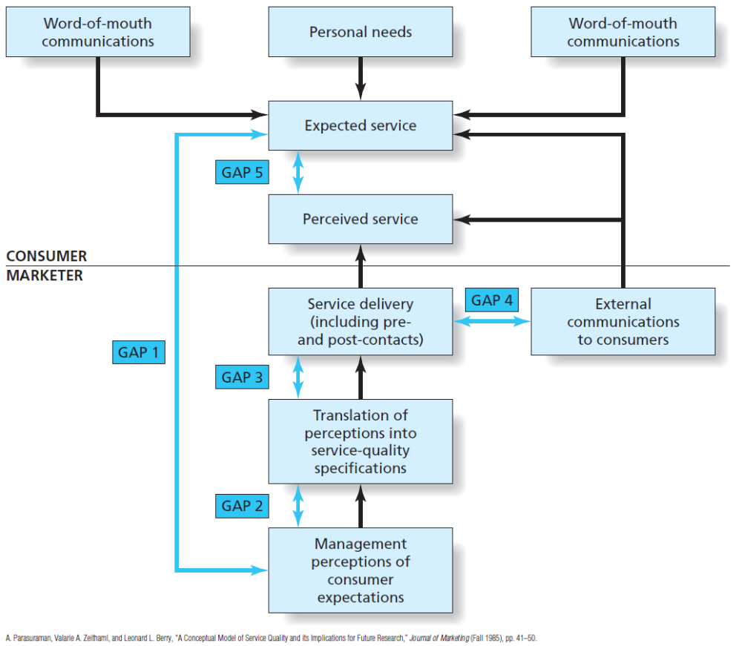
Figure 7.5
The Gap Model of Service Delivery
Copyright © 2013 Pearson Canada Inc.
7-<number>
Notes:
This slide relates to LO #4 of chapter 7.
p. 239
LECTURE NOTES:
Gap between consumers’ expectations and management’s perceptions: when manager’s don’t understand what consumers expect, a major quality gap exists.
Gap between management’s perceptions and quality standards set by the firm: Without a quality control program, service quality suffers, particularly in the areas of responsiveness, accuracy, and timeliness.
Gap between established quality standards and service delivery: One of the largest threats to service quality is poor employee performance. Unfortunately, many firms don’t clearly specify what is expected of employees.
Gap between service quality standards and consumers’ expectations: Service firms should never promise something that they can’t deliver – instead they are better off communicating exactly what customers should expect and what will happen if those expectations are not met.

Slide 34
The Critical Incident Technique
Critical incident technique
    A method for measuring service quality in which marketers use customer complaints to identify critical incidents—specific face-to-face contacts between consumers and service providers that cause problems and lead to dissatisfaction
Copyright © 2013 Pearson Canada Inc.
7-<number>
Notes:
This slide relates to LO #4 of chapter 7.
p. 240
LECTURE NOTES:
The critical incident technique is another way to measure service quality.
The critical incident technique requires that firms collect and analyze customer complaints for critical incidents – specific contacts between customers and service providers that are most likely to lead to dissatisfaction.
Critical incidents may result from simply not being able to meet a customer’s request (sometimes customer requests are unreasonable), or a situation in which the firm may be capable of meeting the request, but fails to do so.
Addressing the problem (moving an airline customer into a different vacant seat when their initial one will not recline) can make customers happy. Even explaining why a problem can’t be fixed at this time may mollify customers if the explanation provided is reasonable.

Slide 35
Strategic Issues When We Deliver Service Quality
Maximizing the likelihood that a customer will use a service and become a loyal user requires
  Development of effective marketing strategies
  Fast and appropriate responses to service failures
Copyright © 2013 Pearson Canada Inc.
7-<number>
Notes:
This slide relates to LO #4 of chapter 7.
p. 240 – 241
LECTURE NOTES:
As the chapter consistently states, service providers struggle to market something that isn’t there (e.g., is intangible). Getting customers to use a service and stay loyal to the provider is a challenge. Similar to goods marketing, the first step is to devise effective marketing strategies that can reach key objectives. Table 10.2 illustrates how three different types of service organizations might devise effective marketing strategies.
To err is human . . . Thus mistakes happen. No matter when and how service failures are discovered, the best thing a firm can do to cement a relationship with the customer is respond quickly in resolving the problem. Research shows that customers whose complaints are resolved quickly are far more likely to buy from the same company again than are those people whose complaints take longer to resolve.
Managers need to understand the potential points where service failures can occur so that they can plan HOW to recover ahead of time. This is why it is so important to identify critical incidents. Employees must be trained to LISTEN for complaints and empowered (allowed) to take actions immediately. When service failures occur, hotel clerks are often allowed to comp meals or even a night’s stay WITHOUT managerial approval (which takes time).

Slide 36
The Future of Services
New dominant logic for marketing
    Argues that service is the central (core) deliverable in every exchange
Services will continue to grow due to several factors
    Changing demographics
    Globalization
    Technological advances
    Proliferation of information
Copyright © 2013 Pearson Canada Inc.
7-<number>
Notes:
This slide relates to LO #4 of chapter 7.
p. 241 - 243
LECTURE NOTES:
The new dominant logic for marketing means that we must rethink our traditional distinction between services and goods. Physical products involved are relatively minor in terms of their contribution to the value proposition while the service aspect is the central element in each exchange.
A number of trends exist that will present challenges and opportunities to service marketers in the future.
Changing demographics: The surge in the birth rate following World War II created the baby boom. As this large group continues to age, service industries which appeal to this demographic will be in high demand (retirement communities, health care, assisted living, etc.)
Globalization: This trend will increase the need for distribution, logistical, accounting, and legal services that have specialized international knowledge. Globalization also means greater competition.
Technological advances: Improvements in technology offer service providers opportunity for growth in the telecommunications, health care, and Internet service industries. Innovation is also likely as some services which will be offered in the future haven’t even been thought of yet.
Proliferation of information: The availability, flow and access to information are critical to the success of organizations. Database services, artificial intelligence systems and communications systems in general stand to benefit in the future.

Slide 37
V. Understand the importance and types of product innovations
Copyright © 2013 Pearson Canada Inc.
7-<number>
Notes:
This slide relates to LO #5 of chapter 7.

Slide 38
“New and Improved!”
The Process of Innovation
Innovation
    A product that customers perceive to be new and different from existing products
    In Canada, the Competition Bureau determines if a product can be termed “new” or not
    Handled on a case-by-case basis
Idea Connection
Copyright © 2013 Pearson Canada Inc.
7-<number>
Notes:
This slide relates to LO #5 of chapter 7.
p. 244
WEBSITE NOTES:
A variety of new technologies and products are listed and briefly explained on the Idea connection web site. Students might find it interesting to visit the site and learn more about the products of tomorrow. The instructor might also want to visit the site before class, find a recent technological process that is discussed, and challenge students to think of ways in which that process might be used or applied in the creation of a new innovation.

Slide 39
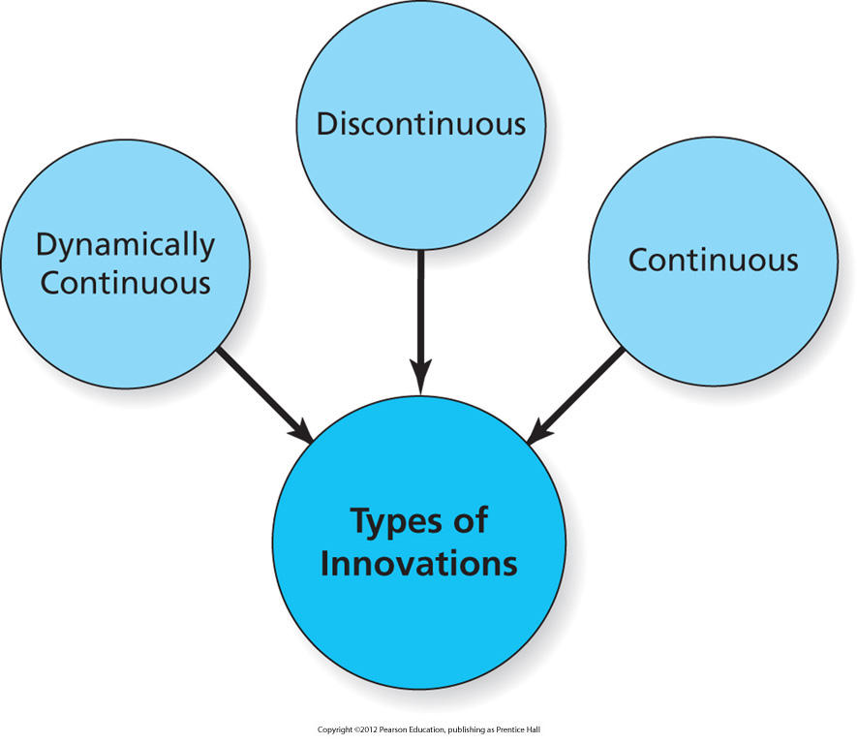
Figure 7.7
Types of Innovation
Copyright © 2013 Pearson Canada Inc.
7-<number>
Notes:
This slide relates to LO #5 of chapter 7.
p. 245
LECTURE NOTES:
Innovations, as perceived by consumers, differ in terms of their DEGREE of newness. Innovations that are radically different from what we are used to require more time to learn, and tend to be more slowly adopted throughout the population as a result.
Figure 7.7 shows that marketers often classify innovations as continuous innovations, dynamically continuous innovation, or discontinuous innovations. The deciding factor that drives the classification is the degree to which the newness of the product changes people’s lives and consumption patterns.
For example, electricity and the light bulb fundamentally changed people’s lives. No longer bound to the rising and setting of the sun, people’s work and life habits changed. Electricity spawned entire new product categories of a wide variety of devices that changed the way people prepared food, cleaned their house, and completed a variety of tasks.

Slide 40

Continuous Innovations
Continuous innovations
    A modification to an existing product
    Sets a brand apart from the competition
    Consumers don’t need to learn anything new; change is minimal
    A Knockoff is a new product that copies, with slight modification, the design of an original product
Copyright © 2013 Pearson Canada Inc.
7-<number>
Notes:
This slide relates to LO #5 of chapter 7.
p. 245
LECTURE NOTES:
Continuous innovations represent the bulk of new products, and are best described as a modification to an existing product.
This type of innovation is often enough to set a brand apart from the competition. New flavors, bigger (or smaller) package sizes, or easy to open child-proof caps, as shown in the Aleve ad, are some examples.
Fortunately, consumers don’t need to learn any thing new to use the product, as the change is minimal. Adoption of continuous innovations is rapid.
Some firms create knockoffs of successful products to sell to a different market. Knockoffs change just enough of the original design of the product to avoid running a foul of the law, and often use cheaper and lower quality materials so the item can be sold for a lower price. Knock-offs are common in the fashion industry, where it is difficult to protect designs (as opposed to technological innovations which are much easier to patent and protect legally).

Slide 41
Dynamically Continuous Innovation
Dynamically continuous innovation
    A pronounced modification to an existing product
    Requires a modest amount of learning or behavior change
Copyright © 2013 Pearson Canada Inc.
7-<number>
Notes:
This slide relates to LO #5 of chapter 7.
p. 245
LECTURE NOTES:
Dynamically continuous innovations are characterized by a major product change. These types of innovations are adopted more slowly than continuous innovations, as a modest amount of learning or behavior change is required before consumers can learn how to use the item.
What are some examples of products that you would consider to be dynamically continuous?
E.G., Audio products. 8-track tapes, cassette tapes, CDs, MP3

Slide 42

Dynamically Continuous Innovations
Convergence is a dynamically continuous innovation
Copyright © 2013 Pearson Canada Inc.
7-<number>
Notes:
This slide relates to LO #5 of chapter 7.
p. 246
LECTURE NOTES:
Convergence is one of the most talked-about forms of dynamically continuous innovations in the digital world. Convergence refers to the coming together of two or more technologies to create a new system with greater benefit than its parts. The merging of cell phones, cameras, personal organizers, games, and video found in today’s smart phones is a great example.

Slide 43
Discontinuous Innovations
Discontinuous innovation
    A totally new product that creates major changes in the way we live
    No similar products has been on the market
    Consumers must learn a great deal to use a discontinuous innovation
Copyright © 2013 Pearson Canada Inc.
7-<number>
Notes:
This slide relates to LO #5 of chapter 7.
p. 246
LECTURE NOTES:
Only those products which create a major upheaval in the way we live are considered to be discontinuous innovations. Consumers must learn a lot to use these innovations and adoption is much slower are a result. For example, computers have been around since the 1950s but it wasn’t until the early 1980’s that personal computers became practical for home purchase and use.
Since then, the personal computer (combined with the Internet) has fundamentally altered the way we communicate, shop, consume media, and work.

Slide 44
IN-CLASS ACTIVITY
List five innovations. Label each
innovation as continuous, dynamically continuous, or discontinuous. Defend your selection of type of innovation.

Slide 45
How Do We Measure Innovation?
Measuring innovation is complicated
Innovation should be measured with respect to
    Firm strategy
    Firm culture
    Outcomes of innovation
Copyright © 2013 Pearson Canada Inc.
7-<number>
Notes:
This slide relates to LO #5 of chapter 7.
p. 246
LECTURE NOTES:
Measuring innovation is difficult because the firm’s overall culture, leadership, and processes that foster innovation all must be taken into account. Here’s a short list of measures that when taken as a whole can provide a firm’s “innovation report card”:
Firm Strategy
• How aware are organization members of a firm’s goals for innovation?
• How committed is the firm and its leadership to those goals?
• How actively does the firm support innovation among its organization members? Are there rewards and other incentives in place to innovate? Is innovation part of the performance evaluation process?
• To what degree do organization members perceive that resources are available for innovation (money and otherwise)?
Firm Culture
• Does the organization have an appetite for learning and trying new things?
• Do organization members have the freedom and security to try things, fail, and then go forward to try different things?
Outcomes of Innovation
• Does the organization have an appetite for learning and trying new things?
• Do organization members have the freedom and security to try things, fail, and then go forward to try different things?
• Number of innovations launched in the past three years
• Percentage of revenue attributable to launches of innovations during the past three years8

Slide 46
VI. Show how firms develop new products
Copyright © 2013 Pearson Canada Inc.
7-<number>
Notes:
This slide relates to LO #6 of chapter 7.

Slide 47
New Product Development
New-product development (NPD)
    The phases by which firms develop new products including idea generation, product concept development and screening, marketing strategy development, business analysis, technical development, test marketing, and commercialization
Copyright © 2013 Pearson Canada Inc.
7-<number>
Notes:
This slide relates to LO #6 of chapter 7.
p. 246
LECTURE NOTES:
For many firms, new products are critical for their long-term growth and success.
Apple has often been heralded for their new product success stories, particularly the iPod. However, they’ve had their fair share of failures too. An interesting article lists Apple’s top 10 failures (with the Apple Newton taking “first place” honors) can be found at: www.newlaunches.com/archives/top_10_apple_products_which_flopped.php.
Key reasons for new product failure include: 1) creating a product with no discernable benefit over existing alternatives; 2) overestimating the size of the market; 3) poor positioning strategy; 4) poor implementation of the marketing mix (bad product quality, pricing too high or low; inadequate distribution; targeting the wrong market; ineffective advertising).
However, following the new-product development process can help firms avoid many of these pitfalls. Let’s talk about this process now.

Slide 48
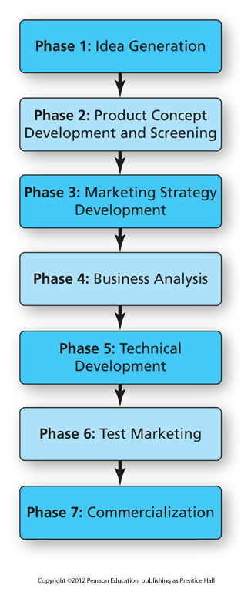
Figure 7.8
Phases in New Product Development
Copyright © 2013 Pearson Canada Inc.
7-<number>
Notes:
This slide relates to LO #6 of chapter 7.
p. 247
LECTURE NOTES:
Seven phases or steps make up the new product development process.

Slide 49
New Product Development (ctn’d)
Phase 1: Idea generation
    The first step of product development in which marketers brainstorm for products that provide customer benefits and are compatible with the company mission
    Focus group is often used to search for new product ideas
Copyright © 2013 Pearson Canada Inc.
7-<number>
Notes:
This slide relates to LO #6 of chapter 7.
p. 247
LECTURE NOTES:
Phase 1: Idea generation.
In this stage, marketers brainstorm ideas generated by customers, employees, service providers, or others that provide customer benefits and which are compatible with the firm’s mission. Focus groups can be particularly helpful in tapping into consumer ideas for new products that related to evolving or changing needs.
Some companies encourage their new product designers to “think outside the box” by exposing them to new ideas, people, and places.
The director of culinary innovation at McDonald’s runs the chain’s test kitchen and he’s challenged with finding new menu concepts that work within the context of a McDonald’s store.
Recently, he came up with a simple idea: He took the breaded chicken the chain uses in its Chicken Selects strips, topped it with shredded cheddar jack cheese and lettuce, added a few squirts of ranch sauce, and wrapped it in a flour tortilla. McDonald’s dubbed it the “Snack Wrap” and put it on the menu at a starter price of $1.29.
A hit was born—the Snack Wrap is one of the most successful new product launches in company history with sales exceeding projections by 20 percent.

Slide 50
Think, Pear & Share
Brainstorm for new product ideas for one of the following :
A backpack with some desirable new features
A combination of shampoo and body wash
A new type of college
Screen one of the ideas for possible further product development.

Slide 51
New-Product Development (ctn’d)
Phase 2: Product concept development and screening
    Product ideas are tested for technical and commercial success
Phase 3: Marketing strategy development
    Developing a marketing strategy to introduce the product to the marketplace
Copyright © 2013 Pearson Canada Inc.
7-<number>
Notes:
This slide relates to LO #6 of chapter 7.
p. 247 - 248
LECTURE NOTES:
Phase 2: Product-concept development and screening
The marketer takes the ideas generated in phase 1 of the process, and expands these ideas into more complete product concepts. Product concepts are screened – meaning they are tested – for both technical AND commercial success. The idea is to weed out those concepts that have little chance of making it if actually produced and released for distribution.
Phase 3: Marketing strategy development
Marketers need to make some fundamental decisions at this stage, including identifying a target market, estimating its size and potential, and determining how to position the product to effectively appeal to the selected target market. Next, planning for pricing, distribution, and promotion is undertaken.

Slide 52
New-Product Development (ctn’d)
Phase 4: Business analysis
    The product’s commercial viability is assessed
Phase 5: Technical development
    Firm engineers refine and perfect the new product
    Prototypes or test versions of the proposed product are developed (in R&D department)
    The firm may need to apply for a patent
Copyright © 2013 Pearson Canada Inc.
7-<number>
Notes:
This slide relates to LO #6 of chapter 7.
p. 248 - 250
LECTURE NOTES:
Phase 4: Business analysis
While the concept development and screening stage estimated the basic commercial viability of the product, the concept is scrutinized in greater detail during the business analysis phase. To be commercially viable, the product concept must make a positive contribution to the overall profit of the firm.
Phase 5: Technical Development
The technical development stage is expensive for firms because engineers begin refining the product concept, develop detailed blueprints, schemata, and models, and actual product prototypes. Prototypes are fully functioning test versions of the product developed by the R&D department.
Prototypes are often tested during focus groups, or by employees within the firm. For example, Gillette employees constantly test new products by shaving when they first come to work.
Prototypes are used by employees responsible for writing instructions, determining which parts will be manufactured internally versus purchased from a supplier as well as what type of new machinery will be needed for the production process.
Often, firms will patent the product during the technical development stage to protect the firm’s investment.

Slide 53
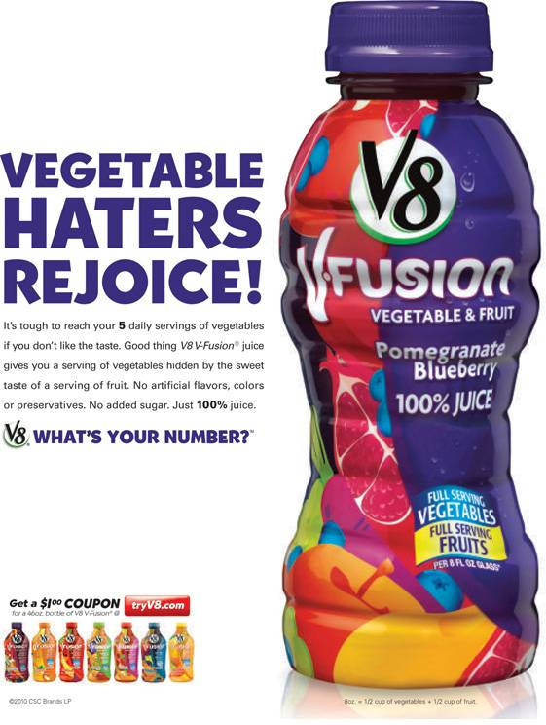
Technical Development
Even continuous innovations such as new beverage flavors may require multiple prototypes and consumer tests as part of the technical development phase
Copyright © 2013 Pearson Canada Inc.
7-<number>
Notes:
This slide relates to LO #6 of chapter 7.
p. 250
LECTURE NOTES:
Creating new beverages or other flavored foods can be tricky. Multiple prototypes are often tested so that the variation which BEST satisfies consumers’ expectations is chosen.

Slide 54
New-Product Development (ctn’d)
Phase 6: Test marketing
    The complete marketing plan is tested in a small geographic area similar to the larger market
Phase 7: Commercialization
    The new product is launched into the market
    Full-scale production, distribution, advertising, and sales promotion are begun
Copyright © 2013 Pearson Canada Inc.
7-<number>
Notes:
This slide relates to LO #6 of chapter 7.
p. 250 – 252
LECTURE NOTES:
Phase 6: Test Marketing
Once the final product configuration is created, a firm may decide to launch the product in a test market for a limited amount of time. During the test market, the entire marketing plan is tested – the geographic market in which the test takes place is exposed to the actual promotion, distribution, and pricing strategy planned for the final product launch.
Not all products warrant a test market though. A new flavored beverage for an established manufacturer probably wouldn’t warrant the expense. Aside from the tremendous cost associated with test market which often run in the millions of dollars, a firm runs the risk of alerting the competition to the new product, which allows them to begin developing a competitive product that much sooner.
However, the benefits can outweigh the costs. For example, test marketing allows marketers to fine tune their entire marketing strategy before taking the campaign and new product introduction national. Sometimes flaws in the product are discovered and fixed.
Sometimes, the firm saves millions of dollars by pulling a product that “fails” its test market.
As an alternative to actual test marketing, more and more firms are opting for simulated test markets that take place online, or in controlled warehouses which mimic a grocery store.
Phase 7: Commercialization
Commercialization is just what the name implies – a full scale launch of the new product. Sometimes products are rolled nationally all at once; other times, a product may be released first into a specific geographic region, with future regional introductions occurring over time as production gears up or as sales grown in the original region.
Commercialization requires careful preparation. Marketers begin by reaching out to the trade, such as retailers and wholesalers who are part of the distribution chain. These organizations must be convinced to carry the product. Publicity aimed at the media is often used to announce the new product, and accompanied by advertising, sales promotion, and other communication tactics geared towards consumers.

Slide 55
VII. Explain the process of product adoption and the diffusion of innovations
Copyright © 2013 Pearson Canada Inc.
7-<number>
Notes:
This slide relates to LO #7 of chapter 7.

Slide 56
Adoption and Diffusion of New Products
Product adoption
    Process by which a consumer or business customer begins to buy and use a new good, service, or idea
Diffusion
    Process by which the use of a product spreads throughout a population
    Tipping point in diffusion
Cloverfield Viral Marketing Case Study
Copyright © 2013 Pearson Canada Inc.
7-<number>
Notes:
This slide relates to LO #7 of chapter 7.
p. 252
LECTURE NOTES:
The last stage of the new product development process occurs when a new product is introduced commercially. Let’s talk about what happens after the product hits the marketplace.
Product adoption is the process by which a consumer or business customer begins to buy and use a new good, service, or idea
In contrast, Diffusion is a process by which the use of a product spreads throughout a population. The point where a product’s sales spike from a slow climb to a new level is called the tipping point. Marketers work hard to reach the tipping point as soon as possible, and undertake a variety of actions to reach and motivate consumers during each stage in the consumer adoption process.
WEBSITE NOTES:
Viral marketing is growing in popularity as a technique that can help stimulate product adoption. Let’s watch the 2 minute video that explains how viral marketing was used prior to the movie’s release to do just that.

Slide 57
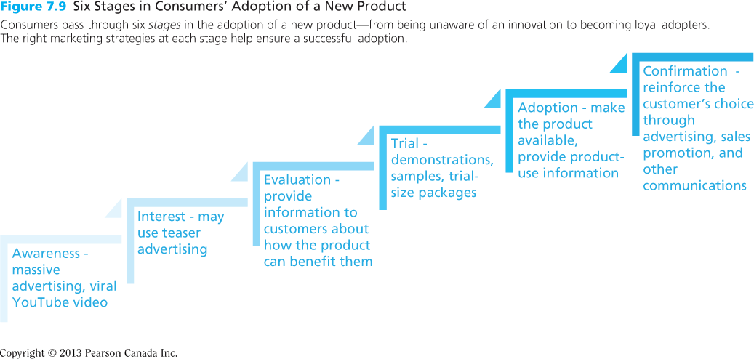
Figure 7.9 Six Stages in Consumers’ Adoption of a Product
Copyright © 2013 Pearson Canada Inc.
7-<number>
Notes:
This slide relates to LO #7 of chapter 7.
p. 253 - 255
LECTURE NOTES:
The steps that leads to consumers’ adoption of an innovation is illustrated in Figure 7.9. The process begins at the ground level, and marketers first task is to create awareness among consumers. Different tactics used by marketers to create interest, spur product evaluations, and stimulate trial, adoption and confirmation are also shown in figure 7.9.
Let’s briefly discuss each step of the adoption pyramid:
A media blitz, or massive advertising campaign and publicity efforts are commonly used to create awareness among the target market.
Prospective adopters become interested when they see how the new product might satisfy a need. Teaser advertising is often used to stimulate curiosity and the desire to look for more information.
Consumers weigh the costs/benefits of the new innovation during the evaluation stage, though some types of products, such as those bought on impulse, may be bought with very little evaluation.
Sampling is the premiere technique for stimulating trial usage of the product among potential adopters, and demonstrations can be critical as well.
During Adoption, the prospect actually buys the product for the first time. But that’s not the end of the process!
After initially adopting the product, the consumer weighs the expected vs. actual benefits and costs. If he or she is satisfied following a favorable experience, the individual is likely to continue using the product for as long as it meets his or her needs better than the competition. Marketers can encourage confirmation via marketing communications by reinforcing the idea that the consumer made the correct choice.

Slide 58

Creating Interest
This ad bills Fruit2day as a “new way to eat fruit” in an attempt to stimulate interest among prospective adopters by showing them how the product satisfies a need
Copyright © 2013 Pearson Canada Inc.
7-<number>
Notes:
This slide relates to LO #7 of chapter 7.
p. 254
DISCUSSION NOTES:
It might be worthwhile to ask other students for recent examples of ads that attempt to build interest for new innovations.

Slide 59
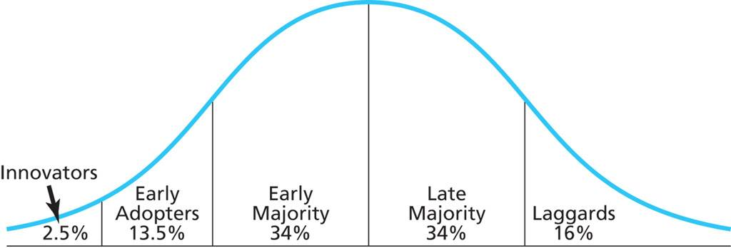
Figure 7.10
Categories of Adopters
Copyright © 2013 Pearson Canada Inc.
7-<number>
Notes:
This slide relates to LO #7 of chapter 7.
p. 255 – 256
LECTURE NOTES:
Recall from our earlier discussion that diffusion describes how a product spreads throughout the marketplace. Some consumers are eager to try new innovations, while others may take a “wait and see” attitude, or be downright skeptical of new offerings. The simple fact is that different people adopt innovations at different times.
Figure 7.10 illustrates this idea – the first to adopt a new product are innovators. These risk-taking, adventurous individuals are young, well educated, and better off financially than most others.
Early adopters are concerned about their standing with peers, and gravitate towards products that will enhance their social acceptance by making them appear to be fashionable or cutting-edge. Marketers will often spend more money targeting the early adopters than they will innovators, knowing that innovators are going to try the product anyways if it is at all relevant to them.
More cautious than either of the first two groups mentioned, those who fall under the early majority are cautious and deliberate in their decision-making. Once they adopt a product, it is no longer considered to be new or all that different. Early majority are middle-class consumers, with slightly above average levels of education and income.
The late majority tends to be comprised of older consumers with lower levels of education and income. Those in the late majority are risk adverse, so they’ll only purchase a product once it has a proven track record and is no longer considered to be a risky buy.
Laggards, the very last group to adopt a product, are rarely, if ever actively targeted by marketers. Tradition bound to the core, laggards often only adopt a product when there is no other alternative. For example, there is a still a small group of men who use a strait razor to shave. As it becomes more difficult for these people to find a replacement razor or to sharpen an existing blade, straight razor users may be forced to purchase either an electric razor or disposable razor.

Slide 60
Product Factors That Affect the Rate of Adoption
Five characteristics affect the speed of innovation diffusion
    Relative advantage
    Compatibility
    Complexity
    Trialability
    Observability
Copyright © 2013 Pearson Canada Inc.
7-<number>
Notes:
This slide relates to LO #7 of chapter 7.
p. 256 – 258
LECTURE NOTES:
Not all products are successful, and the reason for most failures lies in the fact that consumers don’t perceive the new offering as better than what they are already using. Lack of a relative advantage therefore is a key characteristic tied to new product failures. Relative advantage is one of five product factors that researchers have found to affect the speed with which new innovations are adopted.
Relative advantage (also referred to by some authors as a “point of difference”) is the degree to which a consumer perceives a new product as offering superior benefits. Relative advantage typically relates to functional benefits such as higher quality, faster speed, lower cost, greater convenience, etc. All things being equal, the greater the relative advantage, the faster the product should be adopted.
Compatibility is the extent to which the innovation is consistent with existing cultural values, customs, practices, and consumers way of “doing things.” Metal roofs are commonly used in manufacturing and retailing facilities, but are not very prevalent in the consumer market, for several reasons that relate to compatibility, including aesthetics and cost/benefit ratio (metal roofs easily last 30 or more years, but consumers rarely want to pay the higher cost in light of the fact that people move around on average every 5 to 7 years). Lack of perceived compatibility will slow the rate of adoption.
Complexity refers to the degree to which consumers perceive a new product as difficult to understand and use, and as one would expect, the higher the degree of perceived complexity, the slower the rate of adoption. Well-executed marketing communications can reduce consumer perceptions of complexity.
Trialability refers to the ease of sampling a new product and its benefits. The cost to both the consumer and manufacturer influences the degree of trialability. For example, some samples are entirely free (in-store product demonstrations), yielding a high degree of trialability and speeding the rate of adoption. Some marketers make trial-size purchases available at a reduced rate, but this tactic also decreases the trialability factor because consumers must be willing to pay for the product in order to test it. Finally, some products simply aren’t trialable, due to either the cost to the manufacturer or due to the nature of the product (cures for male pattern baldness don’t work with a single application, but rather require longer periods of time and consecutive treatments).
Observability refers to the degree to which others can see the new product and the benefits it provides. If products are not used or consumed in situations where others can see them, they aren’t observable, and that fact could slow the rate of adoption.
Marketers must take care to promote the relative advantage of a new offering in such a way that its superiority to other products is clear. However, no amount of promotion will make up for a LACK of relative advantage, so the desirability and superiority of the relative advantage needs to be carefully tested and evaluated during the new product development process.
Marketers can help overcome perceptions of incompatibility or complexity by carefully planning their marketing communication messages. As previously mentioned, sales demonstrations and sampling can aid in trialability.

Slide 61
All rights reserved. No part of this publication may be reproduced, stored in a retrieval system, or transmitted, in any form or by any means, electronic, mechanical, photocopying, recording, or otherwise, without the prior written permission of the publisher. Printed in Canada.
Copyright © 2013 Pearson Canada Inc.
7-<number>

